Slide 1

Img Social
By Ryan Polkiewicz and Chloe (Aaron) Szucs

Slide 2
About Img Social
Img Social is a online image-sharing website that implements social aspects for a more engaging experience.
User’s can like images, post images, comment on images, and view other user profiles on Img Social.
The website maintains a slick and minimalistic design that helps to hold user attention and maintain the simplicity of the website.
We were inspired to create Img Social by other image-based websites like Pinterest and Imgur.

Slide 3


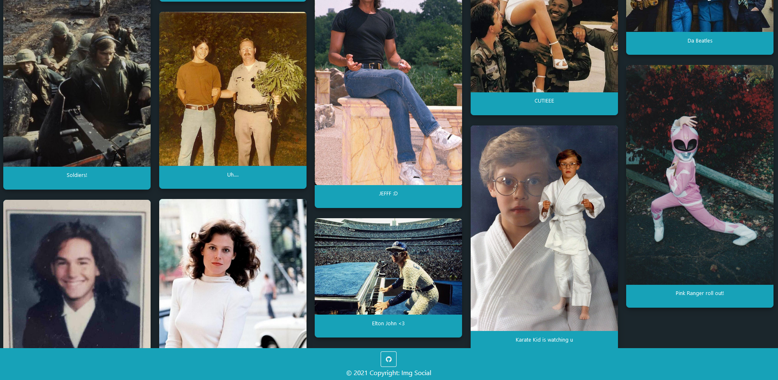

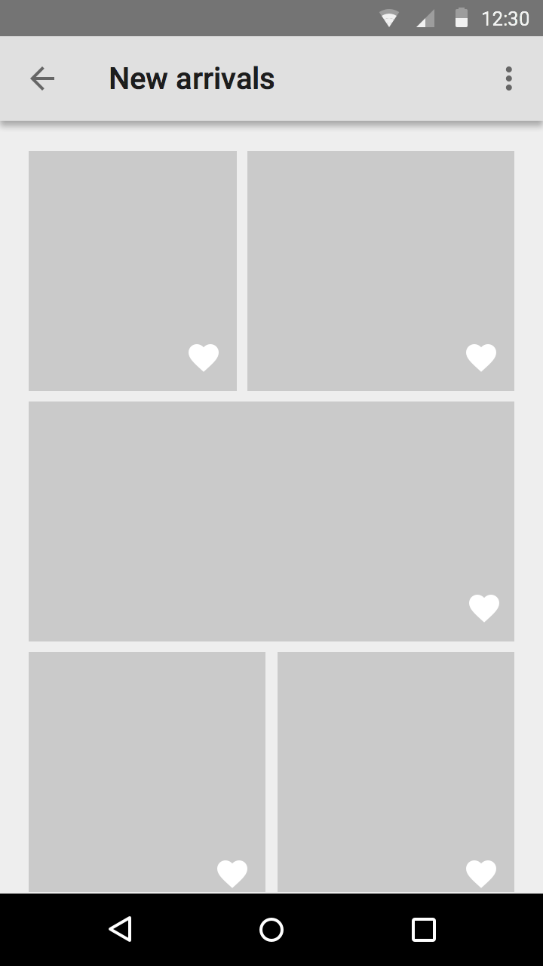
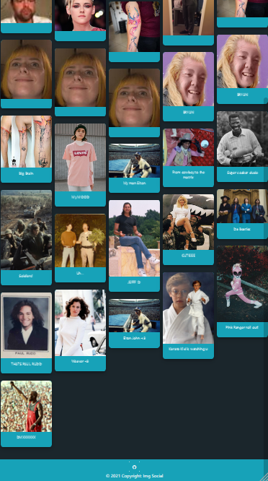
Homepage
Our homepage provides fast and responsive images that lead to comment sections, their likes, and user profile pages.
They are sorted by posted date, so the newest images will always appear near the top instead of the bottom for more user interactivity.
Images are organized in 5 columns of varying height.

Slide 4
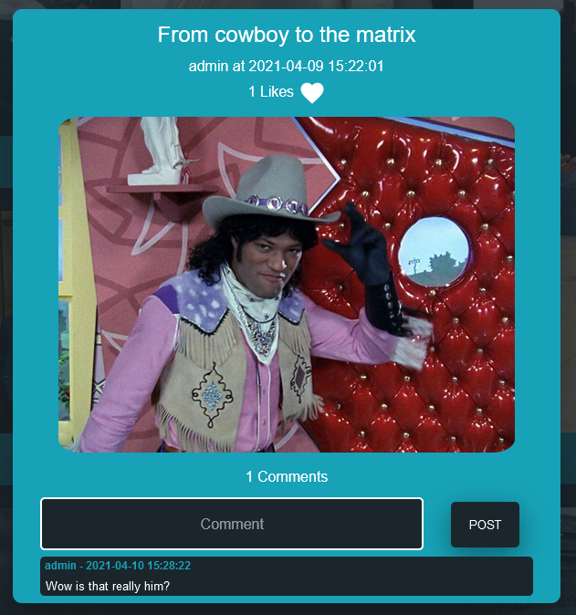
The Content page
Here is our content page. This page is reached by clicking on any image on the Homepage.
The description of the post is at the top as well as the user who posted it. The user’s name can be clicked to view that user’s profile page.
Then there are the likes, each user can only like a specific post once by clicking the heart.
At the bottom are the comment attached to the image. A comment can be made and the page will refresh itself to reveal the newly made comment. The time and account that made the comment will also be posted.

Slide 5
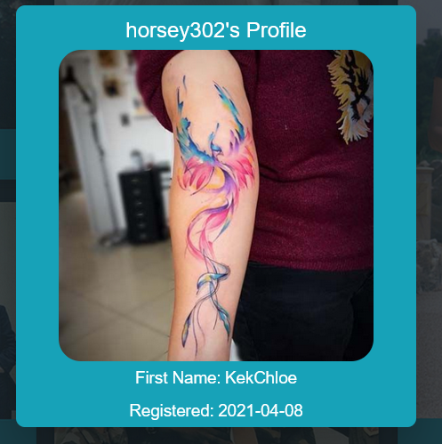
Viewing Another
User’s Profile Page
This is what is shown when viewing another user’s profile page.
As you can see there are no edit and logout buttons, but it still shows the username, profile image, register date, and first name.

Slide 6
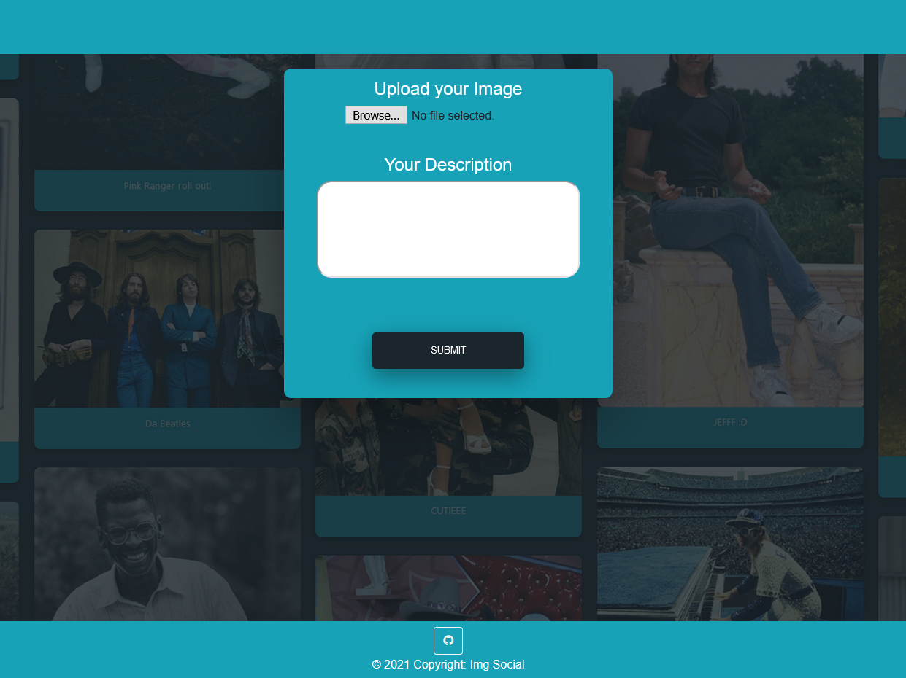
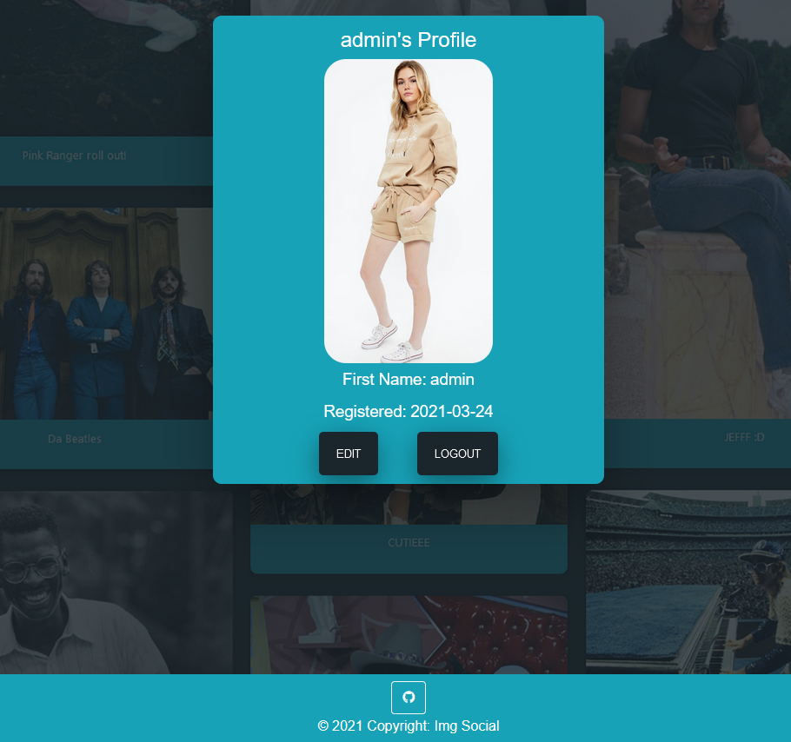
Posting Page
Profile Page
This is our posting page where users can upload images with descriptions to Img Social.
This is the current user’s profile page. The edit button brings down additional settings that the user can change.

Slide 7
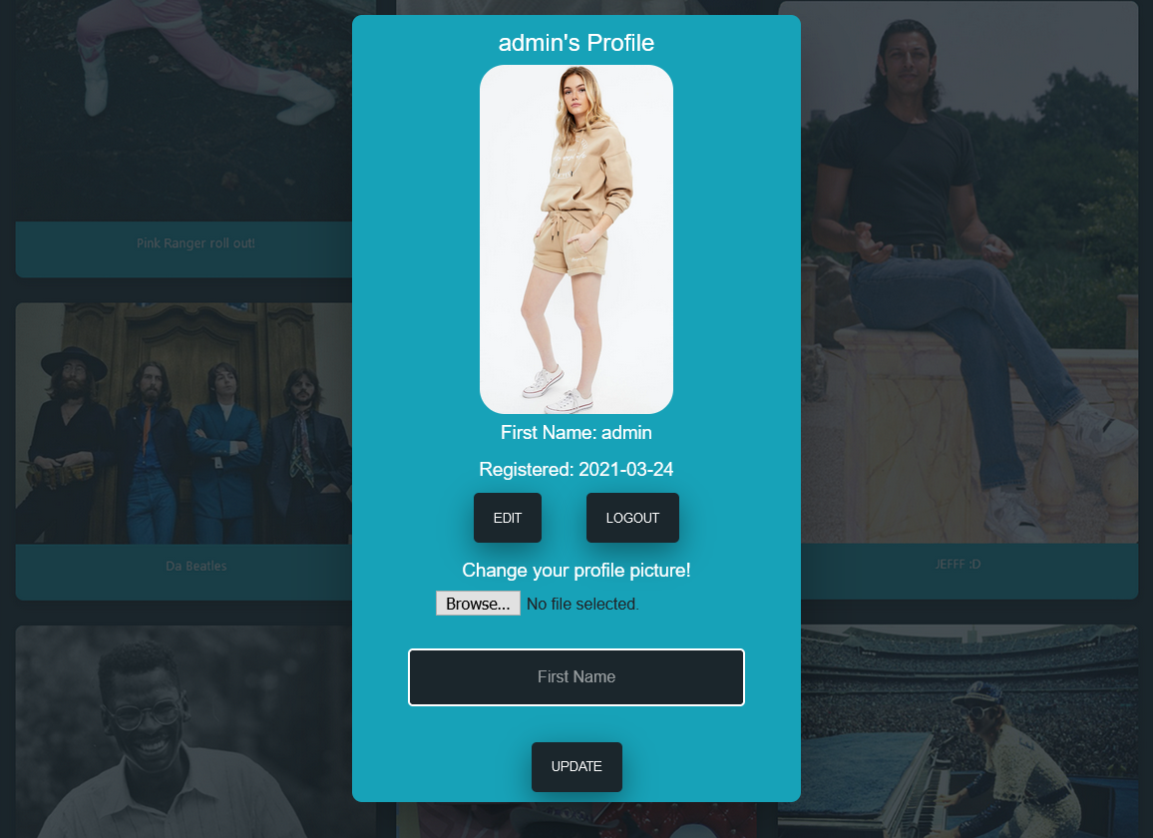
Profile Page ctd.
This is what is shown when the edit button is clicked.
The user can change their profile image and their first name.
Clicking the update button will refresh the page and update our records in the Img Social database.

Slide 8
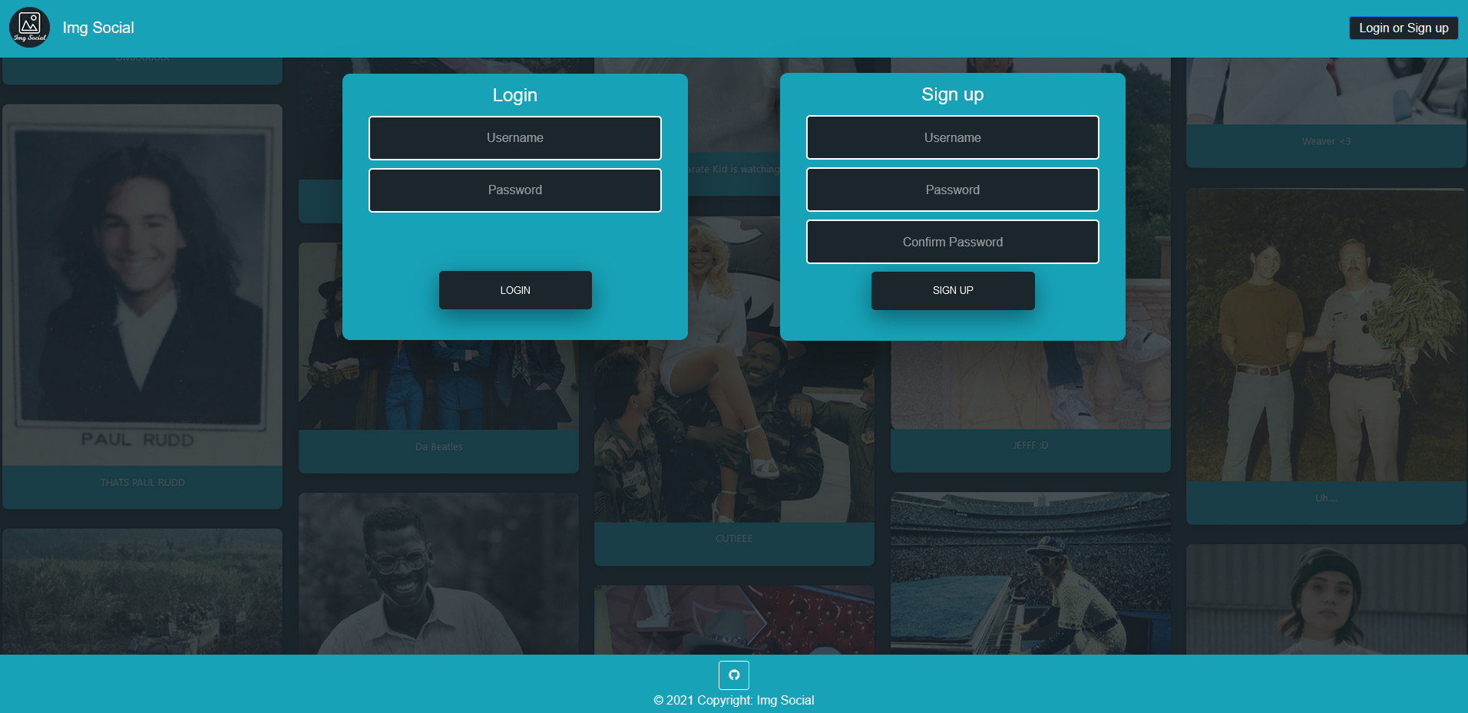
The Login & Signup Page
Lastly, a simple login and signup page that is reachable from anywhere on the site.

